Slide 1
Predictive Model Result

Slide 2
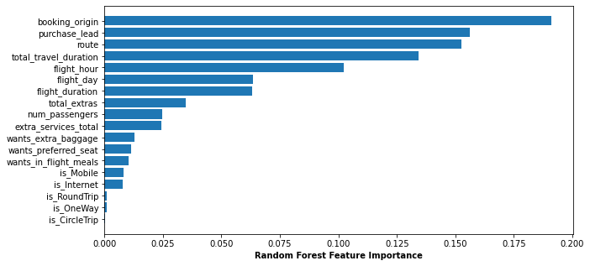
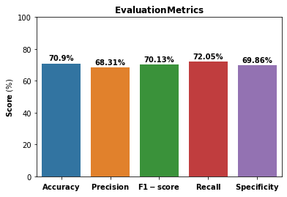
Evaluation Metric & Feature Importance

